Slide 1
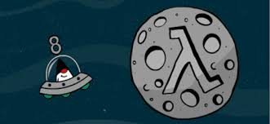
Functional Programming with Java 8
Yogesh Naik

Slide 2
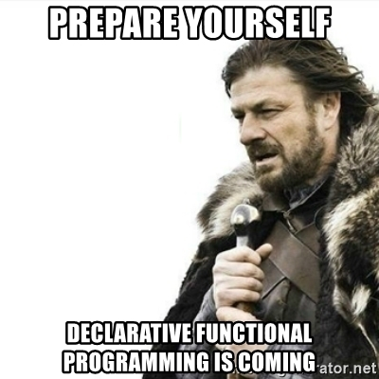
Agenda
History of FP
Introduction to FP
FP + Java 8
Hands on exercise

Slide 3
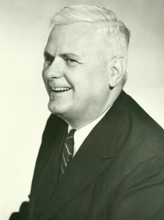
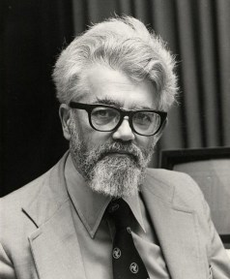
History of FP
FP is based on Lambda calculus which was invented by “Alonzo Church” in “1936”.
Lambda calculus (also written as λ-calculus) is a formal system in mathematical logic for expressing computation based on function abstraction and application using variable binding and substitution
John McCarthy is known as Father of FP as he converted Lambda calculus into a FP language called LISP in 1958.
So FP is very old, about 80 years old. Why is it becoming popular now?

Slide 4
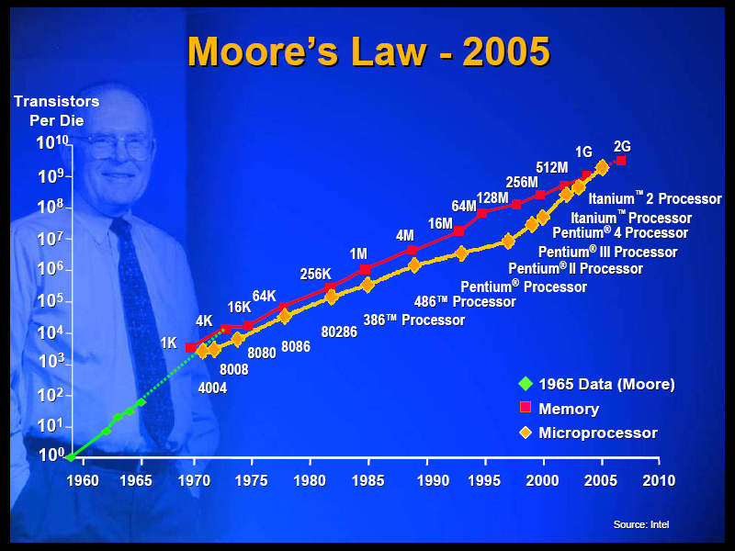
Moore’s Law
The number of transistors per square inch on integrated circuits will double every 1.5 years
This law is not valid anymore because we have hit the physical limit of how small we can make one transistor.
However, we are adding more CPU Cores.

Slide 5
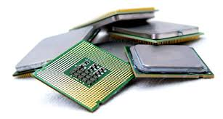
How to utilize multi-core CPUs?
Multi-threading?
It is not enough and is also very hard to achieve due to:
Shared mutable state
Context switching
Co-ordinating between threads across CPU
Rise of Big Data
We have to fundamentally change the way we write computer programs.
Functional Programming to the rescue…

Slide 6

Introduction to FP
Functional programming is
A programming paradigm: style of building computer programs
It treats computation as:
the evaluation of mathematical functions and
avoids changing-state and mutable data.
Example: https://github.com/yogeshrnaik/cdac/blob/master/Programming-Paradigm/Problem%20Solutions/functional%20programming/path.lsp

Slide 7
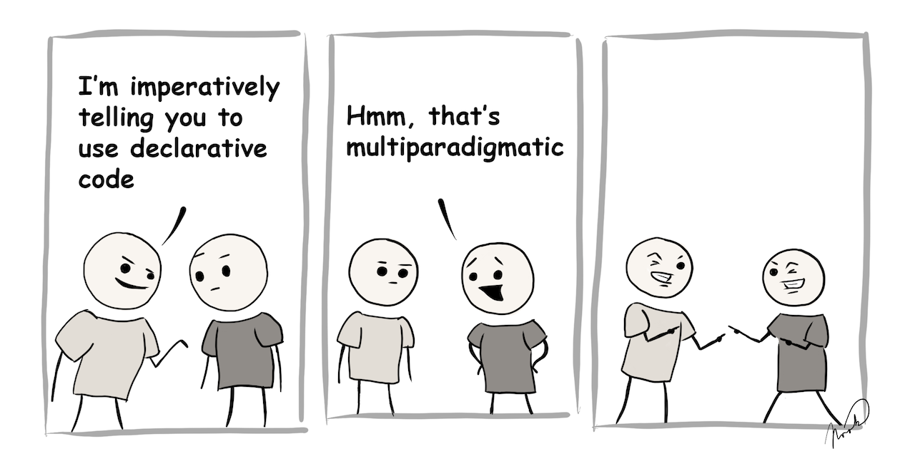
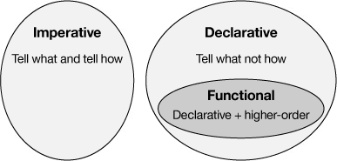
Introduction to FP
Let us look at some examples of Imperative vs Declarative code
It is a declarative programming paradigm, which means programming is done with expressions or declarations instead of statements.
Statements are imperative: open file, iterate collection & check condition for each element, etc.
Expressions are declarative: give me the contents of this file, filter collection using a condition, etc.

Slide 8
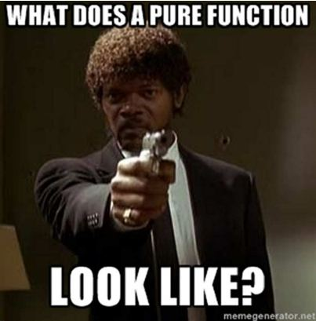
Pure Functions
FP is all about programming with “pure functions” and “functions”
Output of Pure function depends only on Input parameters
Given the same input, it always returns the same value
It does not have any side effects
f(x) = 2 * x + 1
f(2) = 2 * 2 + 1 = 5

Slide 9

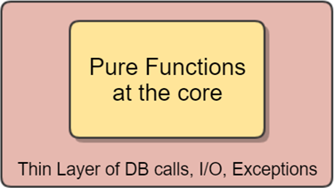
Pure Functions
Pure Functions have no side effects
No state change
No I/O (No file reading/database calls/Sysouts/Logging)
No throwing exception
No threads

Slide 10
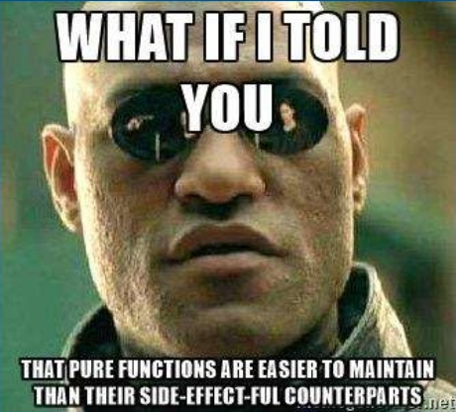
Pure Functions
Let us see examples of Pure vs Impure Functions
Account Deposit example
Buy Coffee example

Slide 11
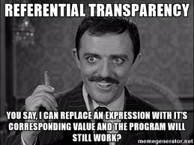
Referential Transparency (RT)
An expression e is referentially transparent if for all programs p, every occurrence of e in p, can be replaced with the result of evaluating e, without changing the meaning of p
A function f is pure if when x is RT, f(x) is also RT
ReferentialTransparencyExample
Memoization
Execution order can be rearranged

Slide 12
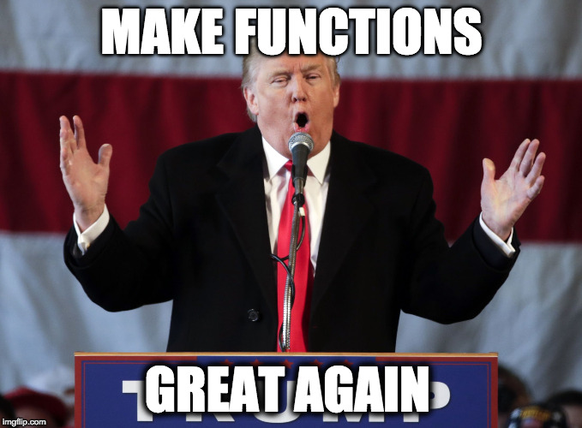
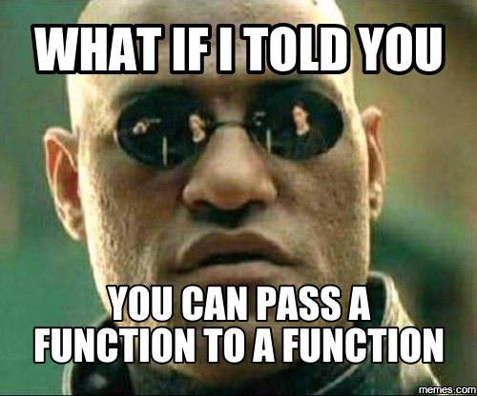
First class Citizens + Higher Order
Functions are First Class Citizens
We can define variables that hold function
We can pass function around as data or variables
Higher order functions
Function that take another function as parameter
Function that return another function
Function that create another function
Let us look at some examples of Higher order functions

Slide 13
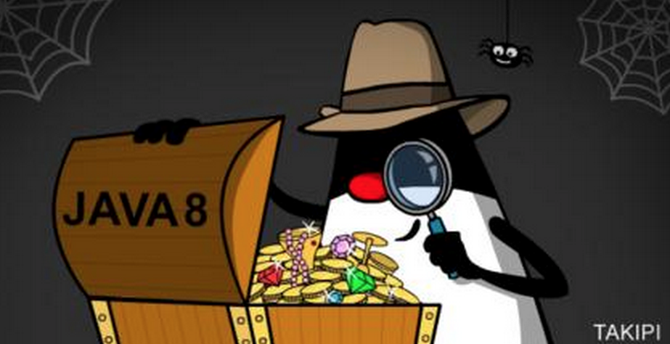

Stream in Java 8
Stream API is introduced in Java 8 to promote the Declarative / Functional style of programming
Streams are Lazily evaluated
Prime Number Example

Slide 14
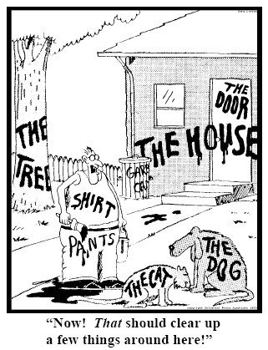
Function Types in Java 8
Java is statically typed language.
Everything must have a “type”
What is the “type” of function:
num -> num *2
lang -> lang.startsWith(“java”)
(num1, num2) -> num1 + num2

Slide 15
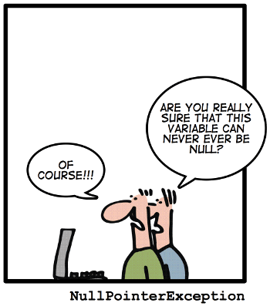
Optional in Java 8
The purpose of the class is to provide a type-level solution for representing optional values instead of using null references.
OptionalExamples

Slide 16
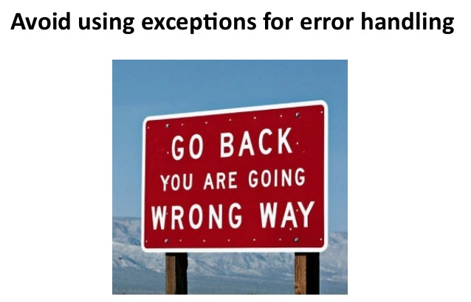
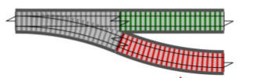
Exception handling functional way
The purpose of the Try class is to provide a type-level solution for representing exception values instead of (playing!) throw and catch.
Account Withdraw Example

Slide 17
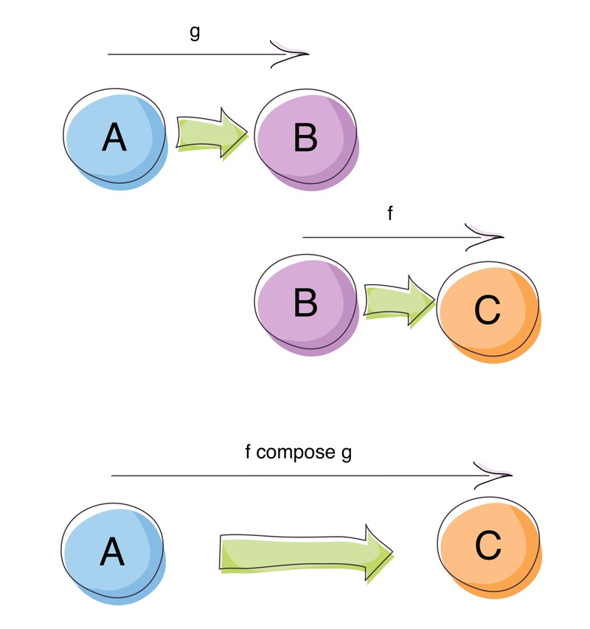
Function Composition

Slide 18
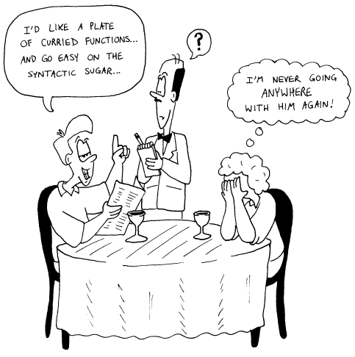
Function Currying
Currying is the technique to break down a function that takes multiple arguments into a series of functions that take part of the arguments

Slide 19

Lazy Evaluation
Lazy evaluation is an evaluation strategy which delays the evaluation of expression until its value is needed.

Slide 20
Partial Function
Partial Function Example

Slide 21
Quiz
Who is creator of LISP?
Name any three functional programming languages?
What are characteristics of Pure Function?
What is Referential transparency?
What is Currying?

Slide 22
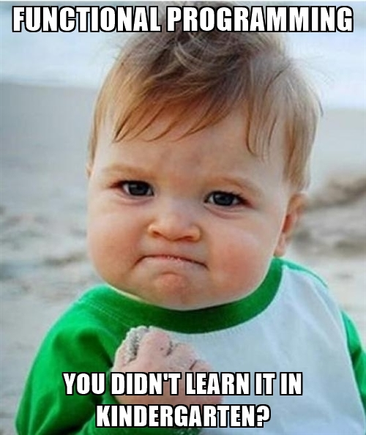
Feedback & Questions?

Slide 23

Let’s code!

